Slide 1
Ch16: Hooke’s Law and Simple Harmonic Motion

Slide 2
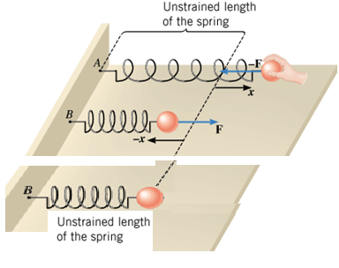

HOOKE'S LAW
The restoring force of an ideal spring is given by,
where k is the spring constant (or force constant) and x is the displacement of the spring from its unstrained length.
The minus sign indicates that the restoring force always points in a direction opposite to the displacement of the spring.
SI unit of k = N/m.

Slide 3
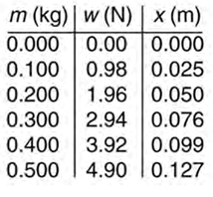
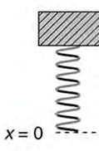
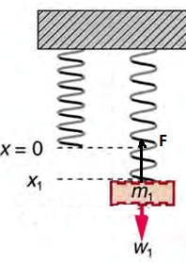
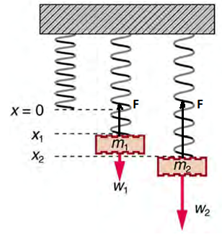
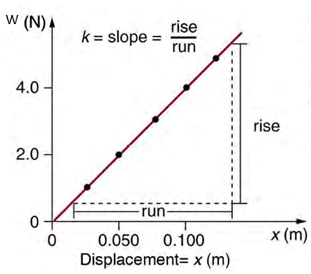
Measuring the Spring Constant, k
W = k x

Slide 4
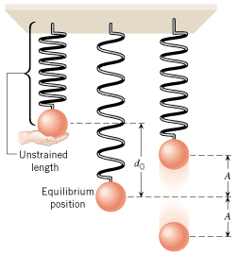
Simple Harmonic Motion
When there is a restoring force, F = -kx, simple harmonic motion occurs.

Slide 5
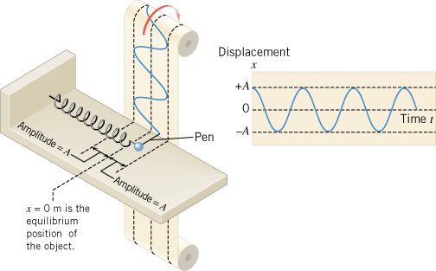
Position VS. Time graph

Slide 6
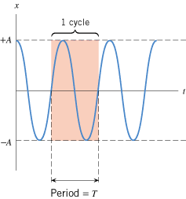
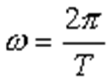

Amplitude, Period, and Frequency
Amplitude is the magnitude of the maximum displacement.
The time required to complete one cycle is the period, T.
The frequency f is the number of cycles of the motion per second.
Angular frequency:

Slide 7
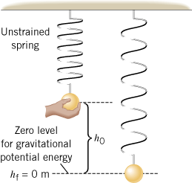
Oscillating Mass
Consider a mass m attached to the end of a spring as shown.
If the mass is pulled down and released, it will undergo simple harmonic motion.
The period depends on the spring constant, k and the mass m, as given below,

Slide 8
How Do Astronauts Weigh Themselves While in Orbit?
Astronauts who spend long periods of time in orbit periodically measure their body masses as part of their health-maintenance programs.
On earth, it is simple to measure body mass, with a scale.
However, this procedure does not work in orbit, because both the scale and the astronaut are in free-fall and cannot press against each other.

Slide 9
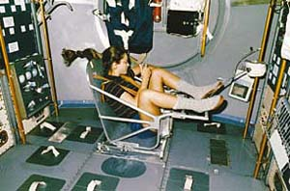
Mass of an Astronaut
This device consists of a spring-mounted chair in which the astronaut sits. The chair is then started oscillating in simple harmonic motion. The period of the motion is measured electronically and is automatically converted into a value of the astronaut’s mass, after the mass of the chair is taken into account.
The spring used in one such device has a spring constant of 606 N/m, and the mass of the chair is 12.0 kg. The measured oscillation period is 2.41 s. Find the mass of the astronaut.

Slide 10
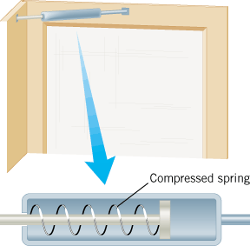
Energy and Simple Harmonic Motion
A door-closing unit
The elastic potential energy stored in the compressed spring is used to close the door.

Slide 11
Elastic Potential Energy

Slide 12
Elastic Potential Energy
The elastic potential energy PE_{elastic} is the energy that a spring has by virtue of being stretched or compressed.
For an ideal spring that has a spring constant k and is stretched or compressed by an amount x relative to its unstrained length, the elastic potential energy is
SI Unit of Elastic Potential Energy: joule (J)

Slide 13
Example 16.2 Calculating Stored Energy: A Tranquilizer Gun Spring
(a) How much energy is stored in the spring of a tranquilizer
gun that has a force constant of 50.0 N/m and is compressed 0.150 m? (b) If you neglect friction and the mass of the spring, at what speed will a 2.00-g projectile be ejected from the gun?

Slide 14
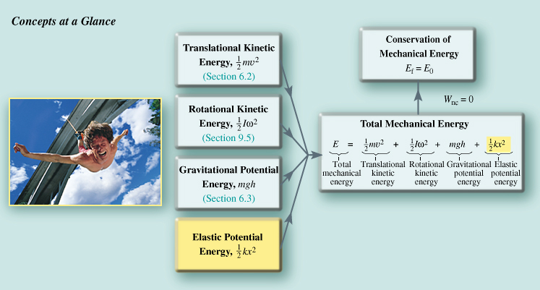
Physics of Bungee Jumping
As the Bungee jumper oscillates up and down at the end of the elastic cord, the total mechanical energy remains constant, to the extent that the non-conservative forces of friction and air resistance are negligible.

Slide 15

Pole-vaulting

Slide 16
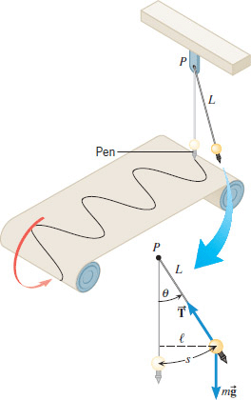
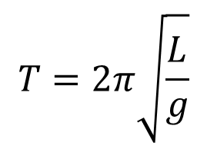
The Simple Pendulum
The period, T of a simple pendulum, of length L:
$$T=2π\sqrt{\frac{L}{g}}$$

Slide 17
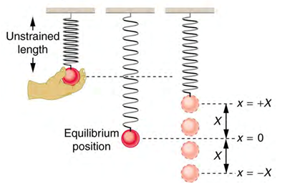
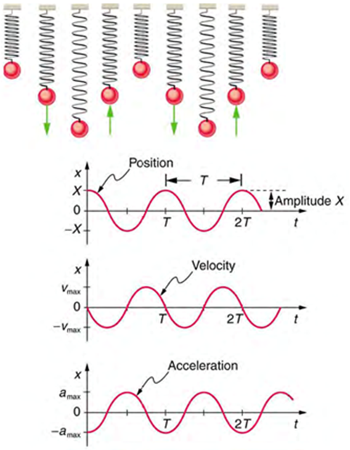
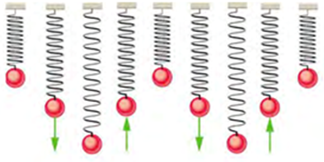
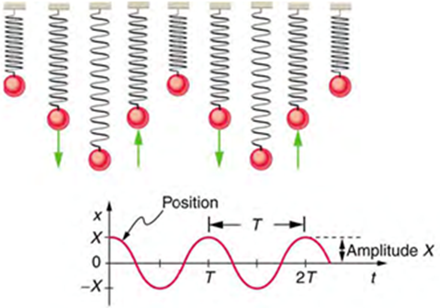
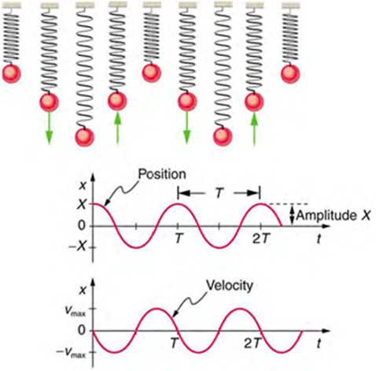
Oscillating Mass on a Spring

Slide 18
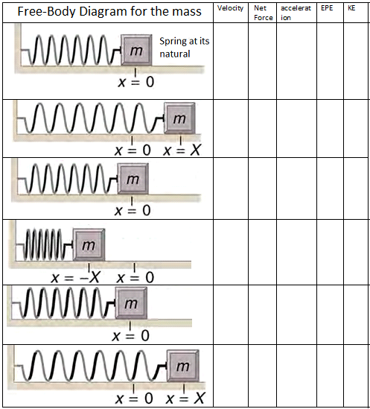
Oscillating mass on a spring

